Slide 1
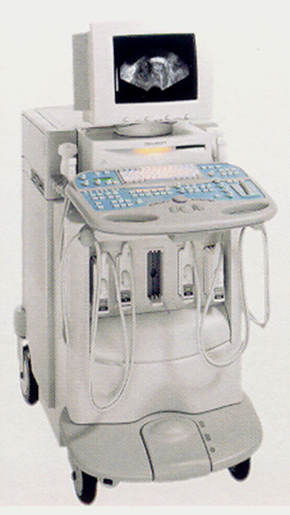
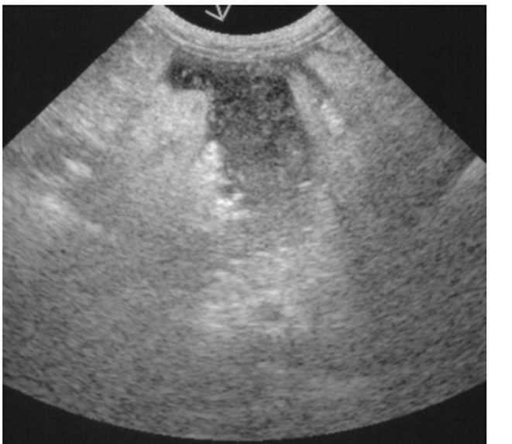
VCS 502 PRINCIPLES OF ABDOMINAL ULTRASONOGRAPHY
DR. I.O. OYENEKAN
DEPARTMENT OF VETERINARY SURGERY AND THERIOGENOLOGY
COLLEGE OF VETERINARY MEDICINE
FEDERAL UNIVERSITY OF AGRICULTURE, ABEOKUTA

Slide 2
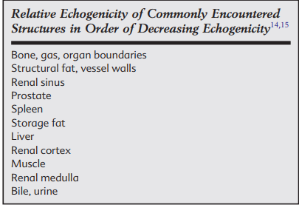
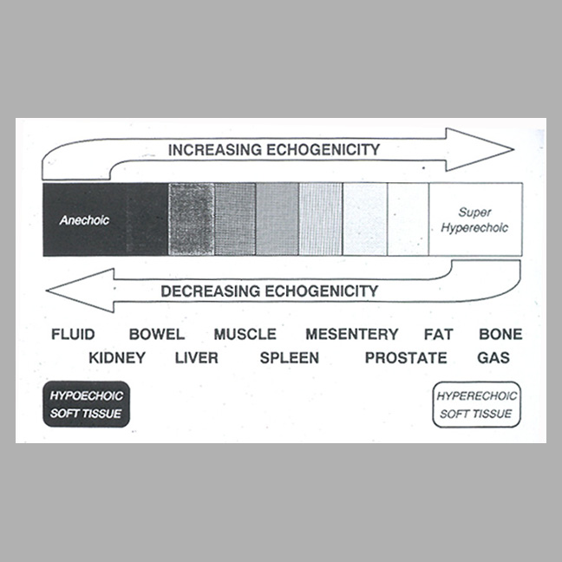
Introduction
Ultrasound is a non-invasive diagnostic test that uses high frequency sound waves to obtain images of body parts for the purpose of diagnosis and evaluation of progress of disease management.
The most commonly performed ultrasounds in animals include abdominal ultrasounds and cardiac ultrasounds.
Abdominal organs are soft tissues with varying echogenicity from anechoic, hypoechoic to hyperechoic.
Sonographic anatomy of abdominal organs vary between health and disease state
Understanding various organs echogenicity is very important in ultrasound diagnosis
Hyperechoic
Hypoechoic
Anechoic

Slide 3
Indications
Disease of the abdominal organs,
Suspected primary or metastatic neoplasia,
Generalised lymphadenopathy,
Ascites,
Abdominal pain,
Trauma or
Diseases of gastrointestinal tract.
A suspected porto-systemic shunt, tumour invasion or thrombus formation.
Pregnancy diagnosis
Anorexia
Vomiting
Intussusception
Blooding stool or vomitus
Urinary tract diseases

Slide 4
Patient preparation, Restraints and Positioning
The animal should have been starved for at least 12 hours prior to the examination especially for sonograph of gastrointestinal tract.
Patients must be clipped prior to the examination
Acoustic gel is applied on the skin to obliterate the probe-air-skin interface and give better access for sound wave penetration
Patient may not need to be sedated for abdominal ultrasound except on rare occasion where the dog is very viscious
For abdominal imaging the animal may be placed in right lateral, Left lateral or dorsal recumbency for the examination
In large animals, abdominal ultrasound can also be performed in standing position

Slide 5
Sonographic techniques
Transducer
Choosing the correct transducer is important. Usually in small dogs and cats a 7.5 or 10 MHz transducer may be used.
With larger dogs, start the examination using a lower frequency, such as a 5 MHz transducer, and then swapping over to a higher frequency.
Examination should be carried out in a systematic way.
The order in which this is performed may be decided by the examiner but it is imperative that the same system is used each time.
Sonographically normal liver, gallbladder, spleen, stomach, colon, kidney, urinary bladder, uterus are visible while pancreas, ovaries, adrenal gland, abdominal lymphnode, prostate gland are not visible sonographically except in disease state with a special ultrasound machine
The liver can be imaged through a combination of subcostal, subxiphoid, and right and left intercostal windows.
Intercostal windows may be the best way to evaluate the liver in a deep-chested dog. The right dorsal intercostal window allows excellent visualization of the porta hepatis, the caudate liver lobe, and the right kidney. Biliary obstruction, and intra- and extrahepatic portosystemic shunts can also be visualized with this window. The selection of transducer and frequency for hepatic evaluation depends on patient size, and size of the liver. Transducer frequencies ranging from 5 to 10 MHz can be used.

Slide 6
Sonographic techniques
The highest frequency transducer that manages to penetrate adequately should be chosen to image the kidneys. In smaller dogs and cats, 7.5 to 15 MHz is appropriate; 5 MHz or lower frequency transducers should be used only in large dogs.
Subcostal or intercostal windows with the patient in sternal or dorsal recumbency allow access to the kidneys, depending on patient size and thoracic conformation. Standard image planes include dorsal (Fig. 38-5, A), sagittal (Fig. 38-5, B), and transverse (Fig. 38-5, C) views, always followed by fanning the transducer through the entire kidney. The renal pelvis is visible best in dorsal and transverse image planes. The ureters can be followed caudally from the renal pelvis if dilated.
High-resolution transducers (7 to 10 MHz) are best for examination of the bladder. A 5 MHz transducer may be necessary to penetrate to the far wall of a distended bladder in large dogs. Linear and curved wide-aperture format transducers are particularly useful. Image contrast settings should be set to high-contrast display; acoustic power and near gain should be decreased to suppress reverberation echoes generated between the transducer, the skin, and abdominal wall structures.
The sonographic examination is best performed when the bladder is moderately full. An empty or nearly empty bladder is difficult to locate because the wall is thicker, and image contrast is reduced. If a nearly empty bladder is encountered, it should be reexamined when it is moderately distended after some hours of inside confinement, after administration of a diuretic, or after catheterization and saline injection. The wall of a flaccid bladder can be deviated inward by a distended
Bladder sonography can be performed with the patient in either dorsal or lateral recumbency. The bladder should be evaluated in a transverse plane and orthogonally in either a sagittal or dorsal plane. Accurate assessment of bladder wall thickness requires a perpendicular orientation of the ultrasound beam with the bladder wall.

Slide 7
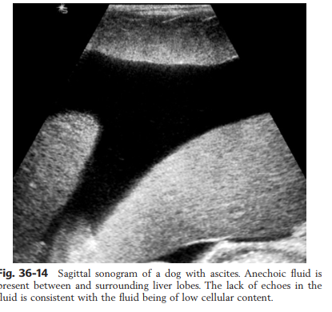
Sonography of the Peritoneal Space
Ultrasound is extremely useful for evaluating the peritoneal space, especially when increased fluid is suspected.
Small fluid volumes can be detected readily and ultrasound guidance can be used to collect samples. Fluid can also be characterized by its echogenicity.
Fluid with low cellular content, such as urine or a transudate, is anechoic; fluid with moderate to high cellular content, such as exudate, blood, or chyle, is more echoic.
The findings of hyperechoic fat, free peritoneal fluid, and a dilated fluid­filled stomach or intestine were considered indirect evidence of gastrointestinal perforation

Slide 8
Sonography of the Pancreas, lymphnodes, adrenal gland
Sonographic evaluation of the pancreas is standard practice for evaluating patients suspected of having pancreatitis or pancreatic masses because the pancreas is better evaluated sonographically than radiographically. The normal pancreas is difficult to identify sonographically because of its small size, echogenicity similar to that of surrounding fat, and lack of a well ­defined capsule
Ultrasound is more sensitive than radiography for imaging lymph nodes. Normal lymph nodes have an echogenicity similar to surrounding mesentery and adjacent musculature and thus difficult to identify sonographically
Ultrasound has been used to evaluate normal canine adrenal glands, normal feline adrenal glands and dogs with hyperadrenocorticism, hypoadrenocorticism and adrenal masses.However, the ability to image the adrenal glands accurately depends on the quality of the equipment, operator experience, and size of the patient. The highest frequency transducer that produces adequate penetration is recommended. Thus adrenal gland are not easily evaluated sonographically

Slide 9
Sonography of the Liver and Gallbladder
Liver
The hepatic parenchyma has medium-level echogenicity with a homogeneous and uniform texture that is somewhat coarser than in the spleen. The normal echogenicity of the liver is isoechoic to either slightly hyperechoic or slightly hypoechoic to the renal cortex and hypoechoic to the spleen
Hepatic and portal veins are visualized routinely within hepatic parenchyma. Hepatic veins are anechoic linear structures extending through the parenchyma. Hepatic vein borders are not echogenic with the exception of their confluence with the caudal vena cava, immediately adjacent to the diaphragm.
Normal hepatic arteries are not visualized easily without color Doppler examination
Gallbladder
The gallbladder is well visualized as an oval, anechoic structure in the right cranioventral portion of the liver. Gallbladder size varies widely, and distention is normal in fasting or anorexic patients.
Intraluminal contents are typically anechoic, although gallbladder sludge, which is dependent echogenic material without acoustic shadowing, is seen frequently and is usually an incidental finding. The normal gallbladder wall is thin and poorly visualized.

Slide 10
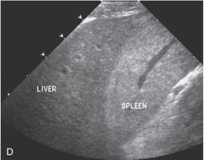
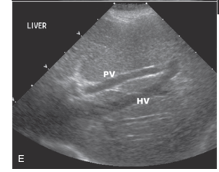
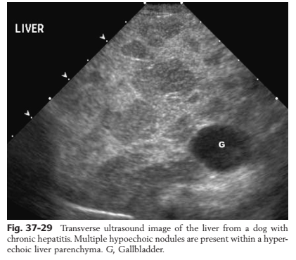
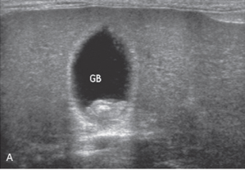
PV= portal vein
HV= Hepatic Vein
GB= Gall bladder with small stones (Cholelyth)

Slide 11
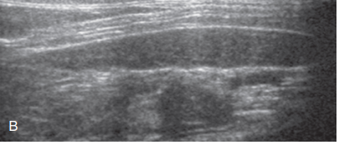
Ultrasound of the Spleen
The canine spleen is well suited to ultrasound examination because it is superficial, and there are no intervening gas-containing structures.
The feline spleen may be difficult to image sonographically in some cats because of its smaller size.
The splenic parenchyma has a uniform echotexture with a fine, dense pattern. Echogenicity is slightly greater than the liver and renal cortex.
S
S=Spleen

Slide 12
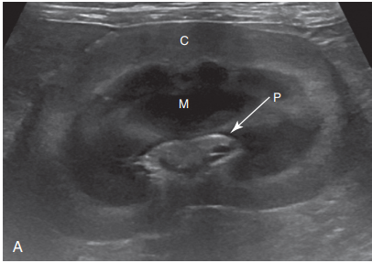
Ultrasonography of the kidneys
Normal canine and feline kidneys are outlined smoothly by a thin hyperechoic capsule and have a clear distinction between cortex and medulla.
The renal cortex in most patients is hypo- to isoechoic to the liver and spleen, although dogs and cats without evidence of renal disease may have a renal cortex that is hyperechoic to liver.
The normal medulla is very hypoechoic, creating a welldefined transition to the cortex. The interlobar vessels and pelvic diverticula give the renal medulla a lobulated appearance.
The arcuate vessels are seen at the corticomedullary junction as short, hyperechoic parallel lines that may produce a distal shadow, not to be confused with renal mineralization.
The renal pelvis usually appear hyperechoic due to dense fibrous tissue.
C=Cortex
M= Medulla
P=Pelvis

Slide 13
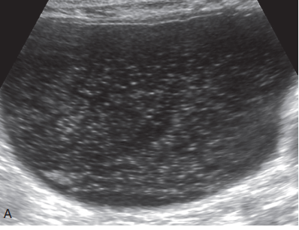
Ultrasonography of the urinary bladder
The fluid-filled urinary bladder is easily evaluated sonographically.
The normal bladder is ovoid in shape with a slight elongation caudally at the neck.
The ureters and urethra are not visualized unless they become distended with urine. With high-resolution transducers, three distinct wall layers can be seen.
The mucosa is a thin hyperechoic surface outlined against the urine, the middle muscle layer is hypoechoic, and the outer serosal layer is hyperechoic.
Normal urine is anechoic.
Thus the urinary bladder wall is hyperechoic with anechoic lumen
Sagittal sonogram of the urinary bladder. Intraluminal, hyperechoic foci representing crystals (crystalluria) are present in the dependent portion of urinary bladder.

Slide 14
Ultrasonography of the gastrointestinal tract
Ultrasound is a useful addition to radiography for evaluation of the gastrointestinal tract. It may eliminate the need for barium studies because gastric motility; wall thickness and architecture; and, to a lesser extent, luminal contents may be evaluated sonographically.
Gas and ingesta within the stomach may obscure the far wall, but the lumen and far wall can be evaluated in those patients in which the stomach contains fluid and little gas.
Ideally, sonography should be performed after a 12-hour fast and before barium is administered. If needed, intraluminal gas can be removed by an orogastric tube and the stomach distended with fluid to act as an acoustic window.
The stomach should be scanned in longitudinal and transverse planes. For evaluating stomach wall layers, 7.5 MHz (or higher) transducers are preferred, but 5 MHz transducers may be needed to evaluate deeper portions of the stomach.
Ultrasound has been used to help diagnose gastric neoplasms, inflammation or infection, ulcers, foreign bodies, pyloric hypertrophy, gastric mineralization,and gastroduodenal and gastrogastric intussusceptions and to evaluate gastropexy sites.

Slide 15
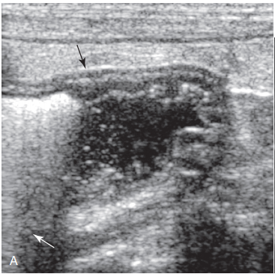
Stomach ultrasonography
The appearance of the stomach varies with the amount of distention and the extent of luminal contents. When empty, the stomach may have a wagon-wheel appearance because of infolding of rugal folds.
With increasing distention, rugal folds become less conspicuous.
Five wall layers corresponding to the mucosal surface, mucosa, submucosa, muscularis propria, and subserosa/serosa can be identified.
These layers have alternating hyperechoic and hypoechoic appearances, with mucosal surface, submucosa, and subserosa/serosa being hyperechoic and the mucosa and muscularis layers being hypoechoic.

Slide 16
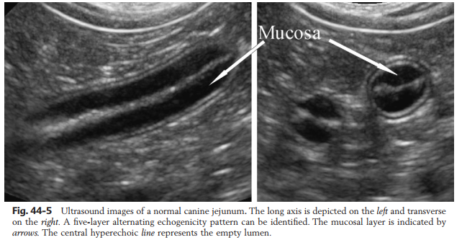
Ultrasonography of small intestine
The normal small intestinal wall pattern consists of alternating hyperechoic and hypoechoic layers. When no fluid or gas is present, a thin, hyperechoic line represents the lumen.
From the lumen to the serosa, the layers and echogenicities are as follows: mucosa and hypoechoic, submucosa and hyperechoic, muscularis and hypoechoic, and serosa and hyperechoic. The hypoechoic mucosal layer is the thickest of the individual layers and thus is dominant visually.
When fluid is in the lumen, the mucosal surface is normally hyperechoic. If gas is present within the lumen, a prominent reverberation artifact occurs in a relatively long length of bowel and a comet tail reverberation artifact is present during peristaltic contraction.
Both of these artifacts inhibit the assessment of the deeper wall. However, the presence of gas helps to identify the lumen in some abnormal segments.

Slide 17
Ultrasonography of large intestine
Ultrasonographic evaluation of the colon and cecum follows the same principles that apply to the small intestine but is somewhat limited because of the reflective nature of feces and gas and the thinner wall of the large intestine.
The colon can be identified in a short axis plane in the region of the urinary bladder neck as the only multilayered tubular structure and by the curved shadowing hyperechoic rim emanating from gas or feces.
In females, care should be taken to differentiate colon from the uterine body, or stump in neutered animals, which is smaller, lacks wall layering, bifurcates in intact females, and normally does not contain reflective material. The colon can then be followed cranially, although not always along its entire course.
The cecum and ascending colon are best located by first identifying the terminal ileum, which has a conspicuous muscularis layer and ileocolic junction in the right midabdomen, in proximity to the right kidney and caudal duodenal flexure.
The cecum should not be confused with abnormally distended small bowel loops or other tubular structures.
Under optimal conditions five wall layers can be distinguished in the large intestinal wall, similar to the small bowel

Slide 18
ULTRASOUND ARTIFACTS
Misrepresentation of structures caused by some characteristic of the imaging technique is an artifact. In diagnostic radiology, artifacts hinder evaluation of the image and are undesirable.
In ultrasound imaging, artifacts are not always undesirable and may actually enhance evaluation of structures by providing insight regarding the composition of structures. For example, sonographic imaging of a fluid­filled structure is characterized by enhancement of soft tissues distal to the fluid­filled structure, whereas with a hypoechoic tissue mass, which may appear similar to a fluid­filled structure, there is no distal enhancement.
Ultrasonographic artifacts includes
Acoustic shadowing
Acoustic enhancement
Reverberation artifacts
Comet-tail and ring-down
Mirror image artifacts
Side lobes and grating lobes
Slice thickness artifact
Refraction
Edge shadowing artifcat

Slide 19
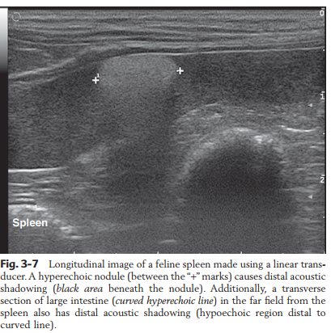
Acoustic shadowing
Acoustic shadows are regions of decreased echogenicity distal to structures of high reflectivity. In these situations, the primary sound beam is almost completely reflected or absorbed.
An insufficient quantity of echoes returned from the location distal to the strong reflector makes these regions appear anechoic (black). The shadowing is a useful artifact because it gives information about the composition of the structure causing the shadowing.
Naturally occurring acoustic shadows are found at soft­tissue/bone and soft tissue/gas, such as in bowel and lung, interfaces.
Pathologic acoustic shadows occur most commonly with renal, cystic, or cholecystic calculi.

Slide 20
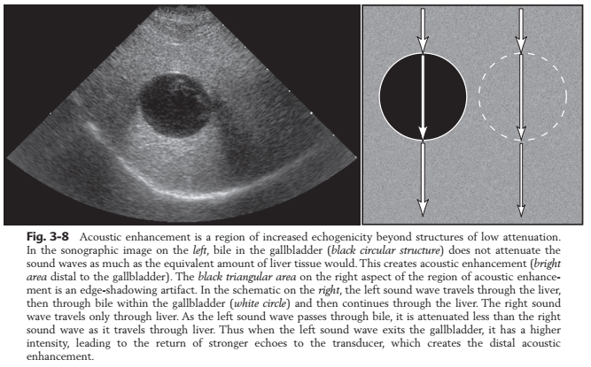
Acoustic enhancement
Acoustic enhancement is a region of increased echogenicity behind structures of low attenuation.
This results in areas of increased echogenicity distal to areas of low attenuation. The two most common sites for acoustic enhancement are distal to the gallbladder and distal to the urinary bladder.
In the gall bladder, sound wave 1 travels through the liver, then through bile within the gallbladder, then through liver again. Sound wave 2 travels only through liver. As sound wave 1 passes through the bile, it is attenuated less than sound wave 2 as it passes only through liver. Thus, at a distance distal to the gallbladder, sound wave 1 has a higher intensity and returns stronger echoes to the transducer.

Slide 21
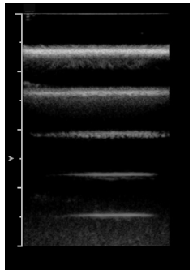
Reverberation artifacts
Reverberation artifacts occur when the sound waves reflect multiple times between two strong reflectors. This violates the assumption that echoes return to the transducer after a single reflection.
Reverberation artifacts appear as multiple hyperechoic foci that occur at regular intervals. The first echo is recorded at the actual depth of the object, and subsequent echoes are at increased distance from the transducer. One of the highly reflective surfaces can be the ultrasound transducer.
Reverberation occurs when the sound wave encounters an area of high reflectivity, such as bowel gas, and the sound wave is reflected back toward the transducer. When the reflected sound wave encounters the transducer, most of it is reflected back into the tissue, where it again encounters the area of high reflectivity.
This cycle of bouncing between the transducer and the patient continues many times, resulting in the regularly spaced hyperechoic foci. The distance between the transducer and the highly reflective surface determines the spacing of the hyperechoic foci
A reverberation artifact was created by submerging a tongue depressor in a water bath. The actual tongue depressor is the strongest hyperechoic line, closest to the transducer, and the four other hyperechoic lines are reverberation artifacts. Some of the sound waves reflected by the tongue depressor are reflected by the transducer instead of being recorded and then are reflected again by the tongue depressor.

Slide 22
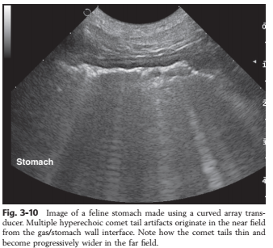
Comet tail and ring-down artifacts
Comet tail and ring-down artifacts are a variation of a reverberation artifact. For comet tail artifacts, the reverberation is caused by two closely spaced, discrete highly reflective surfaces.
Comet tail artifacts can be created by the front and back of a gas bubble or small metallic object such as a pellet.
On the display, comet tail artifacts are typically thin, hyperechoic bands with a triangular, tapered shape in which the sequential echoes are so close together that they are not seen as separate echoes.
Ring­down artifacts are created when ultrasound reverberates within fluid trapped between a tetrahedron of air bubbles.

Slide 23
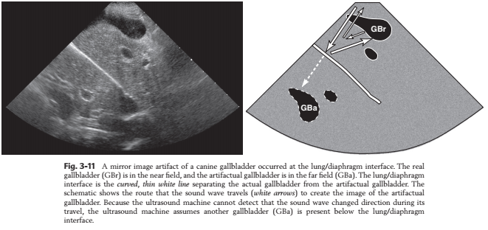
Mirror-image artifacts
Mirror-image artifacts appear as duplication of a normal structure on the opposite side of a strong reflector.
This violates the assumption that echoes return to the
transducer after a single reflection and that sound waves
travel in a straight line.
This is most commonly encountered when the liver is imaged
with the diaphragm/lung interface acting as a highly reflective
structure.
Apparent duplication of the gallbladder can be used to explain the artifact. Normally the sound wave sent toward the gallbladder is reflected back to the transducer and recorded on the screen according to how long it took the sound to return to the transducer.
For the artifactual gallbladder, the sound from the transducer bounces off the diaphragm/lung interface toward the gallbladder, then instead of reaching the transducer, some sound is reflected off the gallbladder back toward the diaphragm/lung interface where it is reflected again toward the transducer.
The sound reflected from the diaphragm/lung interface took longer to return to the transducer; thus an artificial gallbladder is created at an incorrect location within the patient

Slide 24
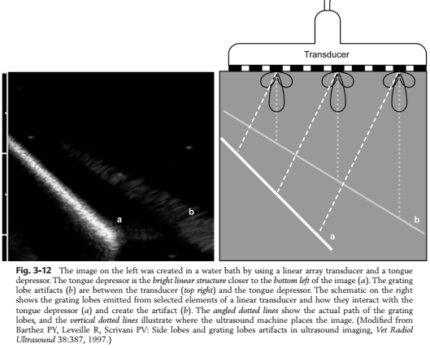
Side lobes and grating lobes
Side lobes and grating lobes are secondary sound beams that emanate in a different direction than the primary sound beam.
Side lobes are associated with all transducers and originate from additional mode vibrations of the piezoelectric crystal.
Grating lobes emanate from array transducers. In each instance these lobes result in an error in positioning of the returning echo.
The side or grating lobes are weaker than the primary sound beam. These lobes must encounter a highly reflective surface and be of sufficient intensity to be noticed

Slide 25
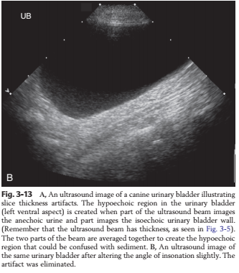
Slice thickness artifacts
Slice thickness artifacts are noticed most commonly in association with the urinary bladder and gallbladder.
In these structures, slice thickness artifacts mimic the presence of sludge or sediment.
A primary sound beam, which is three­dimensional, has thickness. When the periphery of the urinary bladder is imaged, part of the thickness of the primary sound beam strikes the bladder wall while the other part strikes anechoic urine.

Slide 26
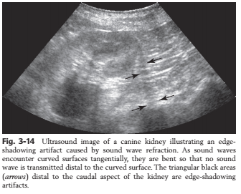
Edge-shadowing artifacts
Edge-shadowing artifacts are refraction artifacts that are created when sound waves are bent as they encounter a curved surface tangentially.
Anechoic regions are present distal to the curved surfaces because of absence of sound waves that have been bent by the curved surface.
The edge­shadowing artifact occurs commonly when the kidneys, urinary bladder, or gallbladder is imaged. Edge­shadowing artifact can be eliminated with spatial compounding

Slide 27
Normal Abdominal Structures¹
Organ | Location | Size / shape / normal findings
Stomach | 8th -13th ICS left mid-ventral | Semi-circular, wall < 0.75 cm Adjacent to splenic vein
Small intestine Duodenum Jejunum Ileum | Ventral to right kidney, between right liver lobe and right dorsal colon Not always seen, usually ventral Can be between spleen and stomach Not always seen, usually ventral | 6-15 contractions / min Wall < 0.3 cm Wall < 0.3 cm Wall < 0.4-0.5 cm
Caecum | Right caudodorsal abdomen | Wall thickness not repeatable
Large intestine | Ventral and lateral abdomen | 2-6 contractions / min Sacculations present except in dorsal colon Content causes acoustic shadow
Small colon | Caudal abdomen | Image through distended bladder
Liver | Right 6th – 15th ICS Left 6th – 9th ICS | Right lobe atrophy common in older horses Sharp margin Homogenous parenchyma Branching vasculature
Spleen | Left 8th ICS – paralumbar fossa extending to ventral abdomen | Few blood vessels Homogenous Most echogenic organ
Right kidney | Right 14th – 17th ICS Adjacent to body wall | 13-15 cm long 15-18 cm wide 5 cm thick Least echogenic organ
Left kidney | Left 17th ICS – paralumbar fossa Medial to spleen | 15-18 cm long 11-15 cm wide 5-6 cm thick Least echogenic organ
Urinary bladder | Usually imaged trans-rectally | Only visible from ventral window if distended Wall 0.3-0.6 cm Urine normally echogenic (crystalluria normal)
Peritoneum |  | Small amount of anechoic fluid

Slide 28
Abdominal ultrasound: abnormalities associated with disease conditions
Disease condition | Ultrasonpgraphic abnormalities
Gastric impaction or dilation | Enlarged stomach
Gastric neoplasia, gastritis or ulceration | Thickened gastric wall
SI mechanical obstruction | SI distension oral to obstruction, Empty SI aboral to obstruction, Wall thickness may increase with time
Functional ileus | Little or no motility in affected segment, Diameter normal or increased
Strangulating SI obstruction | SI oral to obstruction usually > 3 cm diameter, Increased wall thickness in affected segment Decreased / absent motility (+/- sedimentation)
Nephrosplenic entrapment | Inability to visualize left kidney, Spleen displaced ventrally
Large colon impaction faecal impaction sand impaction | Round viscus lacking sacculations, Absent peristalsis Normal to very slightly increased wall thickness Hyperechoic line casting acoustic shadow from mucosal surface Hyperechoic particles causing reverberation artifacts
Colitis / typhlitis | Increased wall thickness, Fluid-filled lumen, Altered motility (increased / decreased)
Intussusception | Target / bull’s eye
Inflammatory bowel disease / neoplasia | Localized or diffuse echogenic wall thickening
Peritonitis | Increased volume and echogenicity of peritoneal fluid, Fibrin and/or adhesions, Decreased or absent GI motility, Increased GI wall thickness
Haemoperitoneum | Free swirling, homogenous hypoechoic fluid, Clots (hypo-/hyperechoic) may develop
Abdominal abscess | Variable appearance, Can be poorly marginated or capsulated, Hyperechoic to hypoechoic content, May contain gas
Hepatic disease | Rounded margin, Increased or decreased echogenicity, Increased or decreased size
Calculi (cystic, nephroliths, choleliths, etc.) | Cast acoustic shadows
Renal disease edema cellular infiltrate medullary rim sign | Changes in size, shape. architecture or echogenicity, Less echogenic More echogenic Indicative of primary renal disease

Slide 29
THANK YOU

